Slide 1

How To Use MyS3
Encrypt your files on the fly and sync with Amazon cloud
Ove Bakken
Revision 2
September 7th, 2020
Norway, Innlandet

Slide 2

Welcome!
How To Use MyS3
Ove Bakken
Since you’re here you’re probably curious about how you use MyS3.
This user manual has two parts: The Amazon cloud resource setup (1) and how to use MyS3 (2). MyS3 itself is very simple (and intuitive) and shouldn’t require reading a manual. But if you feel unsure you’re welcome to study it, and to send me questions.
MyS3 is simple software, but also fairly new. Please let me know if you experience any problems you believe to be bugs. If you’re running Windows you can use the console client or the graphical interface client. However, Linux and Mac OS users can only run the console client for now.
All executables can be found at github.com/flaskevann/MyS3.
If you don’t trust the uploaded builds, feel free to download the necessary GitHub projects yourself and make your own. After installing the needed NET Core tools all you have to do is run the build command.

Slide 3
Getting started
How To Use MyS3
Ove Bakken
1) Do you have an Amazon Web Services (AWS) account? If not, you need to create one:
aws.amazon.com/premiumsupport/knowledge-center/create-and-activate-aws-account/
.. and then afterwards in this user guide:
2) You setup your own resources in the Amazon cloud
Meaning you create your own space with Simple Storage Service (S3), and then you give yourself access with access credentials from Access Management (IAM). Everything can be done directly using AWS Management Console. It’s very easy if you follow the instructions.
Don’t worry too much about the expenses. S3 is very price competitive. You have to upload or download a good amount before even breaking $1. Please see AWS S3 pricing for details:
aws.amazon.com/s3/pricing/
The rest of this user guide will assume you have access to AWS.

Slide 4
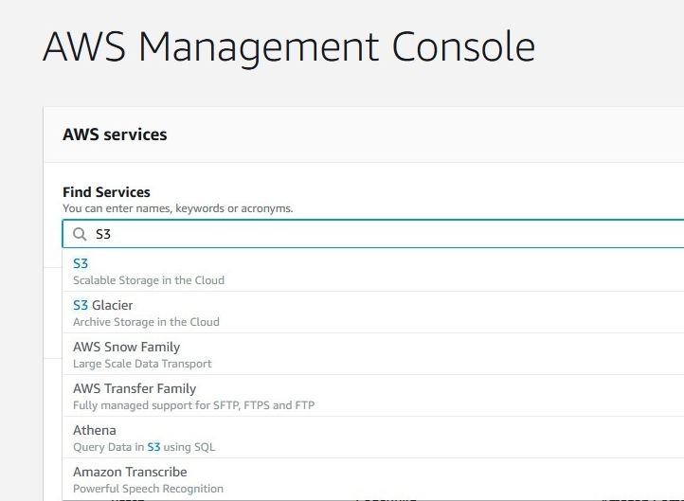
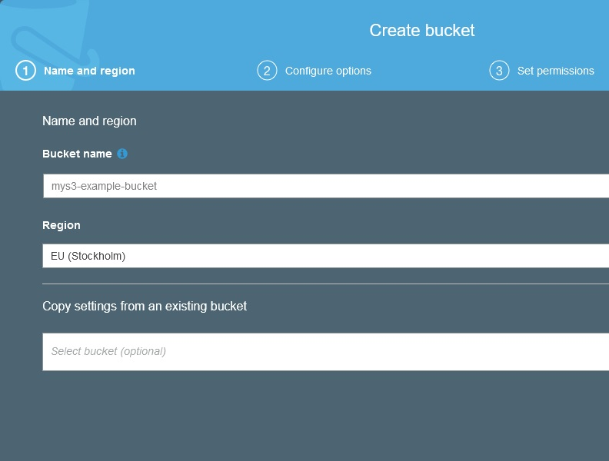
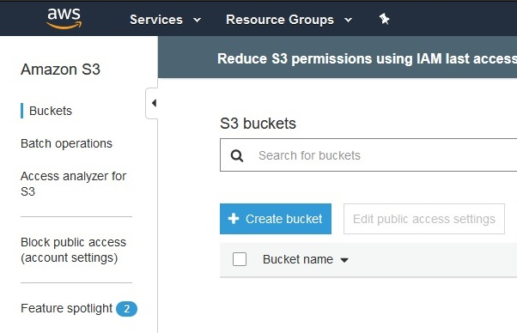
Setup S3 Bucket
How To Use MyS3
Ove Bakken
First things first, you need to setup your own S3 space. (AWS calls this a ’bucket’.)
You log onto AWS Management Console (1), select S3 (2), and find a bucket name (3):
1
3
2
>
>
>
>
Region: Select closest or cheapest!

Slide 5
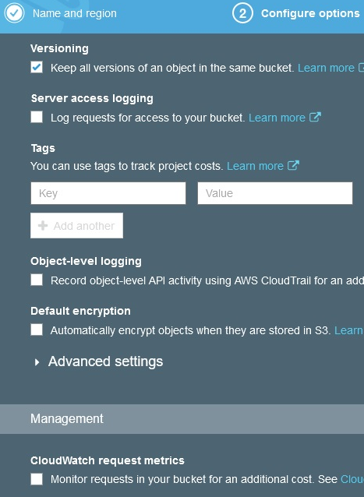
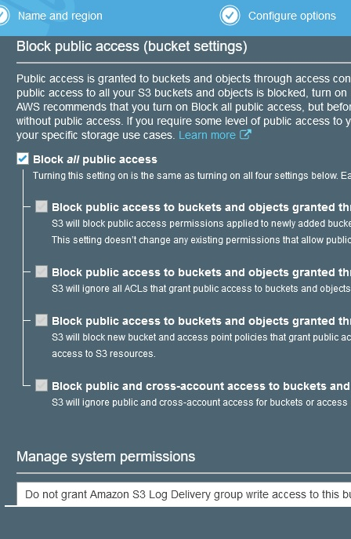
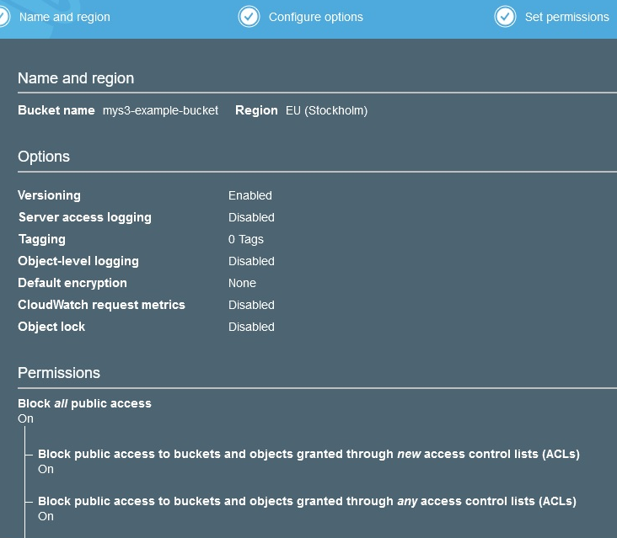
Setup S3 Bucket
How To Use MyS3
Ove Bakken
Continue the setup. Do enable versioning (1), but use default settings for the rest:
>
1
2
3

Slide 6
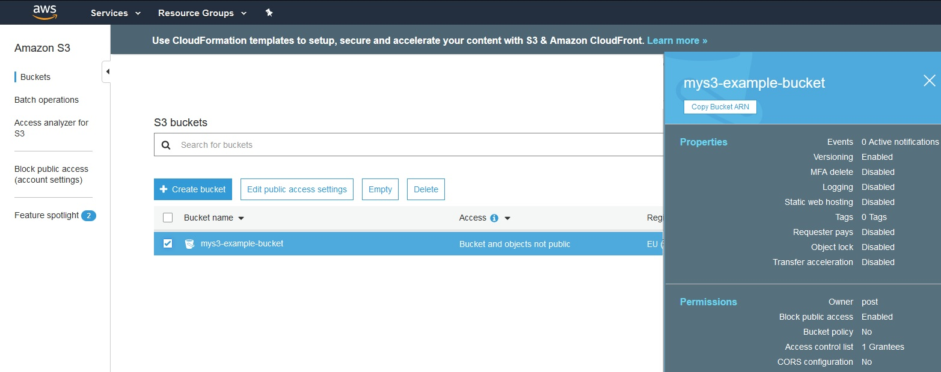
Get S3 Bucket ARN
How To Use MyS3
Ove Bakken
After you’ve created your bucket (Yey!), copy bucket address (ARN) to a text document:
<
>
(Bucket ARN is needed when setting up your access credentials next!)

Slide 7
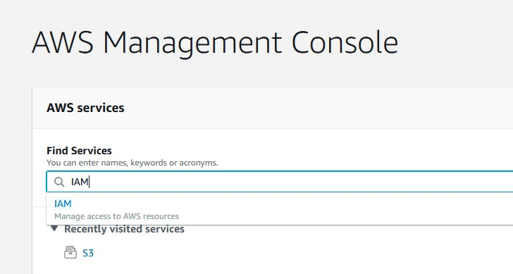
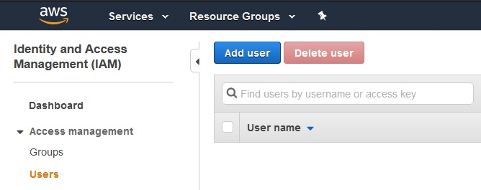
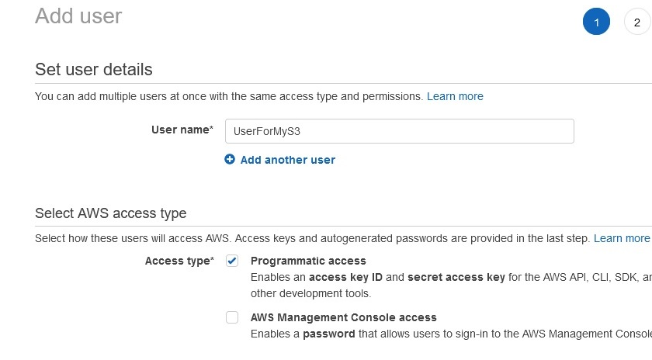
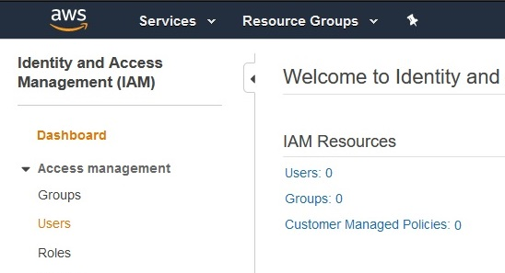
Setup IAM User
How To Use MyS3
Ove Bakken
Now that you have your S3 bucket ready, you need a sort of user profile MyS3 can assume:
Go to AWS Management Console. Select IAM (1), Users (2), Add user (3) and start setup (4):
1
3
>
4
>
<
2
<
>
>
Select a user name and check Programmatic access.

Slide 8
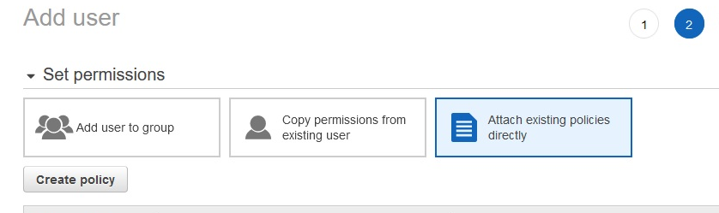
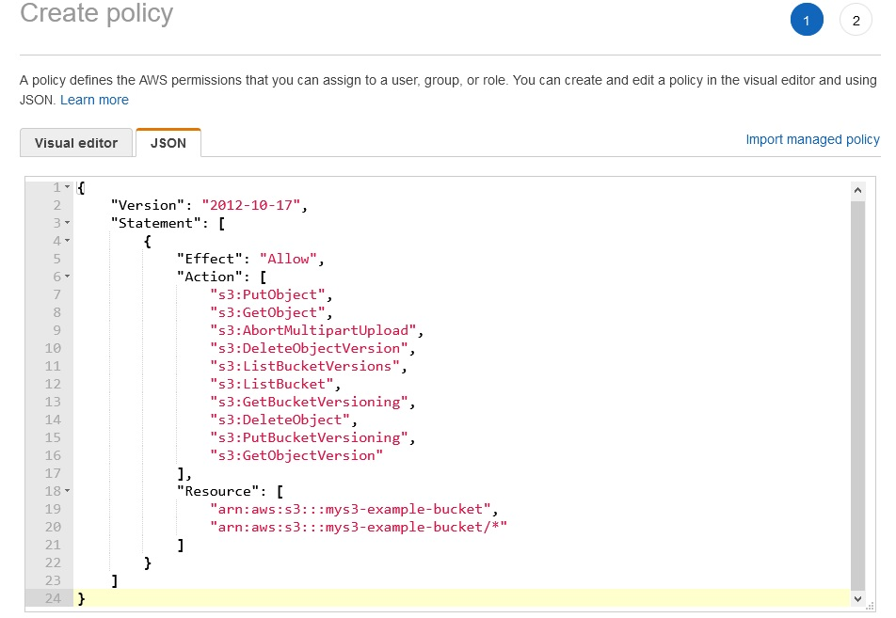
Setup IAM Policy
How To Use MyS3
Ove Bakken
Click create policy (1), this opens a new browser tab. Go to JSON (2) and put in text (3):
1
2
<
<
3
{
"Version": "2012-10-17",
"Statement": [
{
"Effect": "Allow",
"Action": [
"s3:PutObject",
"s3:GetObject",
"s3:AbortMultipartUpload",
"s3:DeleteObjectVersion",
"s3:ListBucketVersions",
"s3:ListBucket",
"s3:GetBucketVersioning",
"s3:DeleteObject",
"s3:PutBucketVersioning",
"s3:GetObjectVersion"
],
"Resource": [
"arn:aws:s3:::mys3-example-bucket",
"arn:aws:s3:::mys3-example-bucket/*"
]
}
]
}
Put in your own bucket ARN twice at bottom.
Don’t delete /*

Slide 9
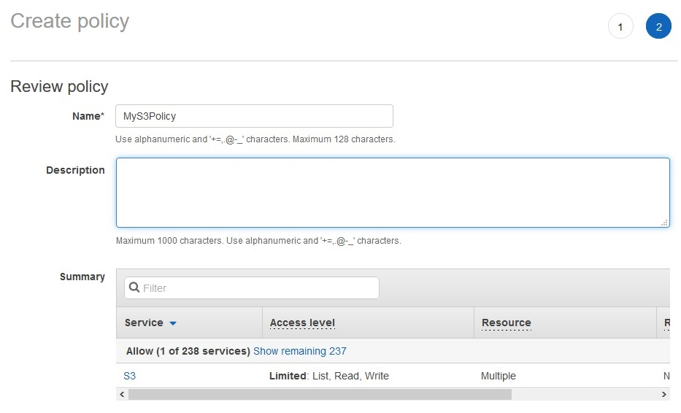
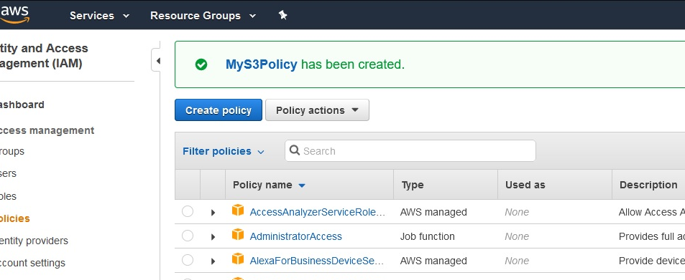
Setup IAM Policy
How To Use MyS3
Ove Bakken
Give your policy a fitting name (1) and finish it. IAM should then say it’s created (2).
1
2
<
(The policy giving access to your S3 bucket now
exists, and only has to be added to MyS3’s user.)

Slide 10
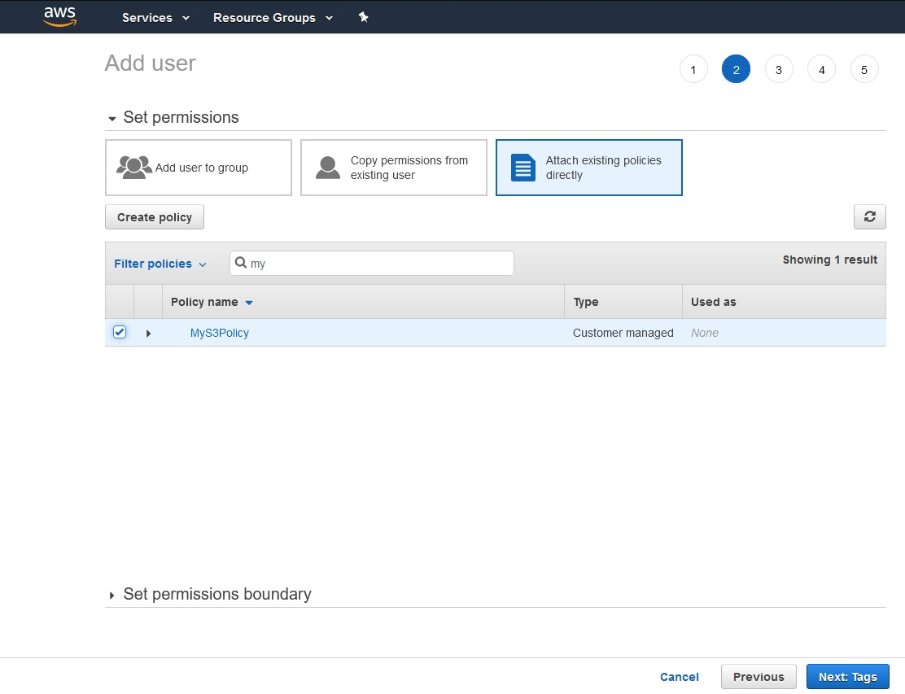
Setup IAM User
How To Use MyS3
Ove Bakken
Go back to the browser tab where you began setting up your user and refresh the list.
Find your newly created policy by typing the first few letters, then check it and hit next:
>
<
>
v

Slide 11
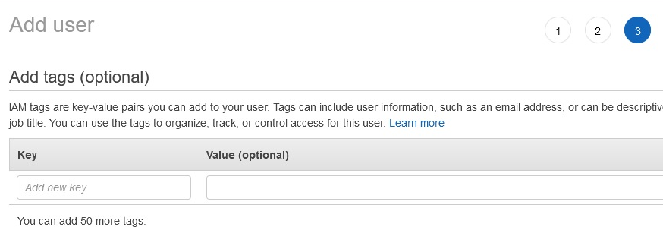
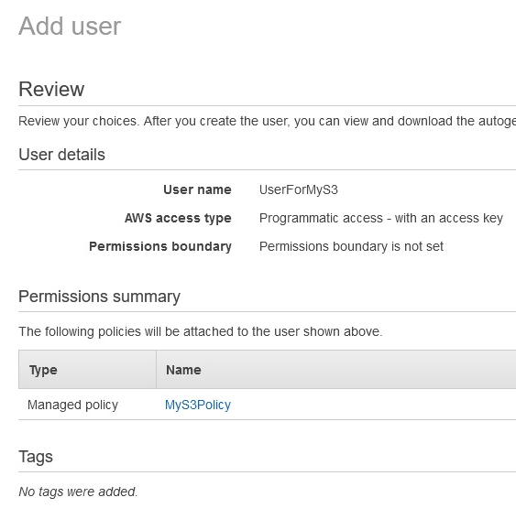
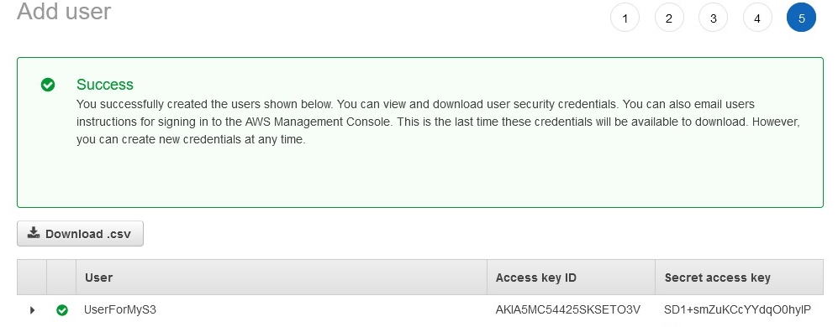
Setup IAM User
How To Use MyS3
Ove Bakken
The next step is tags (1). Please skip this. Then comes a review (2) and finally the
credentials screen (3) which gives you your access credentials:
1
2
3
Please download csv-file and keep it safe. (It gives access to your S3 bucket!)

Slide 12
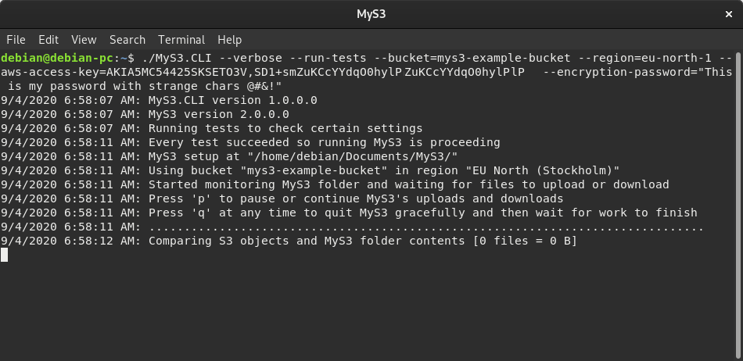
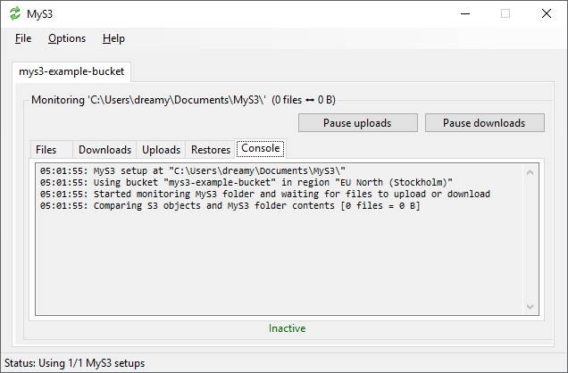
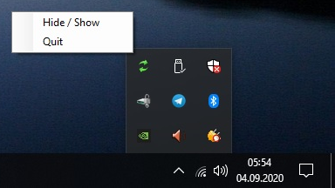
The MyS3 Clients
How To Use MyS3
Ove Bakken
With your own S3 bucket and access credentials you can now setup MyS3 and start
uploading whatever you want, without being surveilled.
How it looks when you get the console client (1) or GUI client (2-3), and you run your setup:
1
2
3
(A working console client setup can of course be put into a script file later for convenience.)

Slide 13
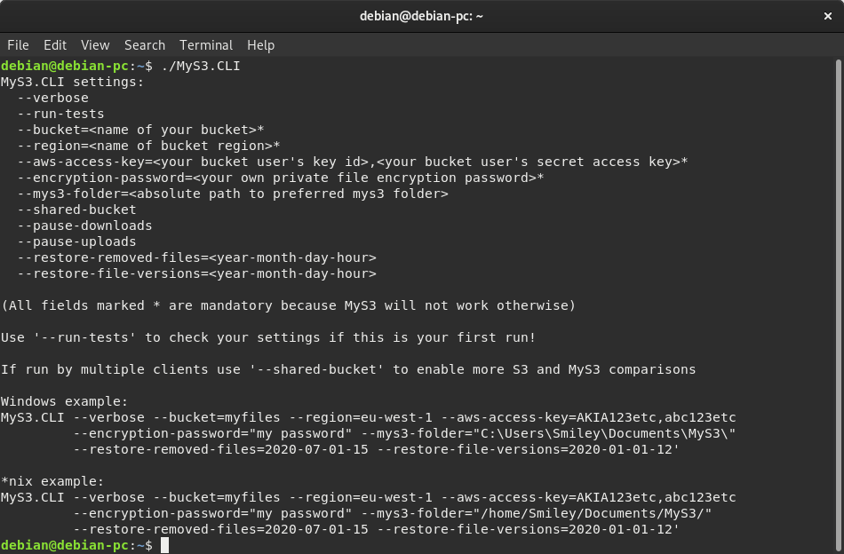
Console Client
How To Use MyS3
Ove Bakken
Use of the console client is straightforward; just type in the necessary settings:
Don’t be afraid to make a mistake. MyS3 will tell you if there's a problem.

Slide 14
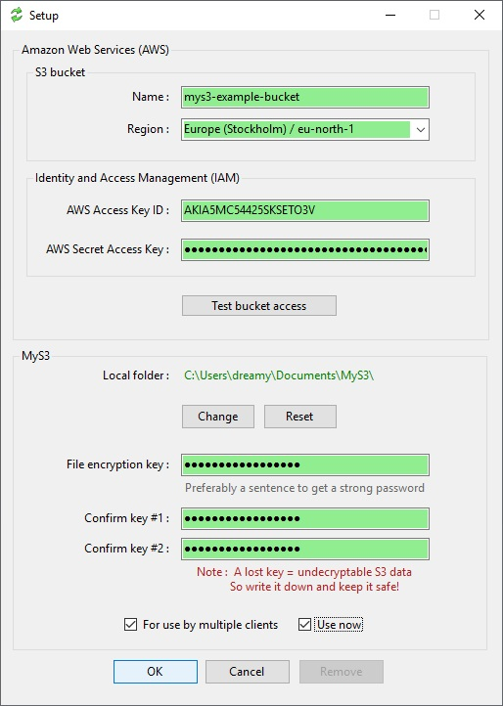
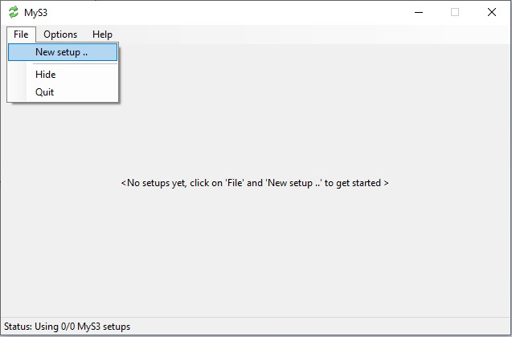
Graphical Interface Client Setup
How To Use MyS3
Ove Bakken
2
When you run the graphical interface client (1)
you get a lot of help with your setup (2):
1
(Tip: Copy and paste in all your settings for
greater speed and accuracy!)

Slide 15
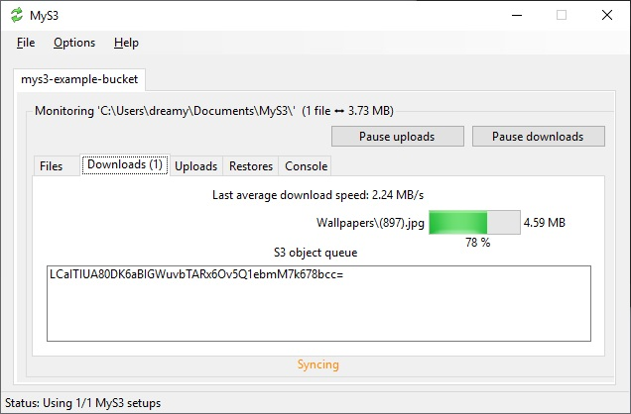
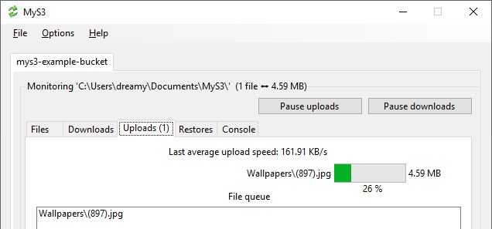
Graphical Interface Client Sync
How To Use MyS3
Ove Bakken
When MyS3 runs a setup it starts looking for new S3 bucket objects and it starts monitoring
file activity (1). Then it does the necessary work (2-3) when something finally happens:
1
2
3

Slide 16
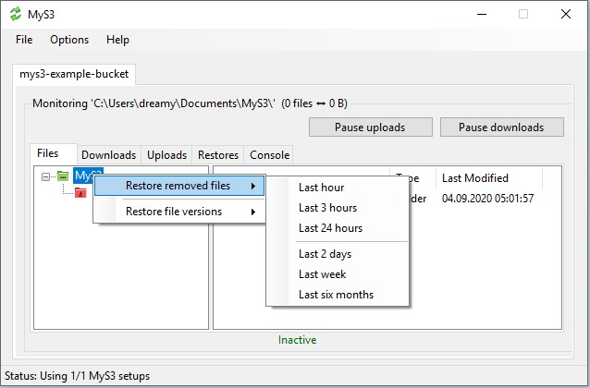
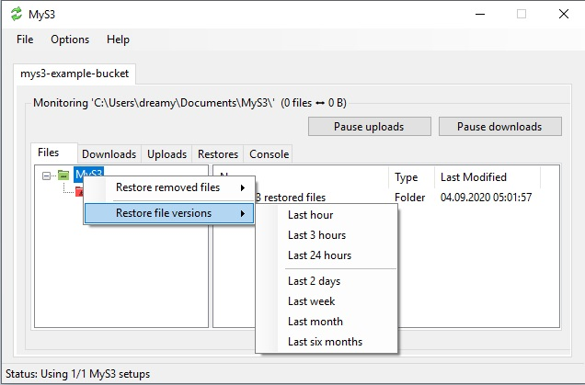
Graphical Interface Client Restore
How To Use MyS3
Ove Bakken
To restore last removed files (1) or earlier file versions (2), right click on the root in the Files tab:
1
2
(Removed files gets added back to the same folder they were removed from.)
(Earlier file versions also gets added back, but root becomes the MyS3 restored files folder.)

Slide 17
Missing Features
How To Use MyS3
Ove Bakken
File Sharing: Since MyS3 encrypts all files and file paths before upload, sharing file links
is not possible. However, you can always create another bucket and share it with
somebody you trust. Because MyS3 is able to run multiple setups at the same time.
Password Recovery: MyS3 is not a file hosting service like Dropbox, etc. Meaning you
have nowhere to turn if you lose your file encryption password. Which is why you
should write it down and keep it in a safe place! You can also not change your
encryption password whenever you feel like it, because all your files and file paths have
already been encrypted with the current password and then uploaded.
To set a new file encryption password: 1) Remove your setup from your MyS3 client and
quit the client. 2) Log onto the AWS Management Console and empty your entire S3
bucket. 3) Restart your MyS3 client and add back your setup with the new file encryption
password, and click OK. 4) Wait for MyS3 to sync your files all over again, this is
everything in your MyS3 folder.

Slide 18
A Few Gotchas
How To Use MyS3
Ove Bakken
MyS3 only compares last changed timestamps when deciding if a file needs to be uploaded, or an S3 object downloaded. This is a problem if you still have copies of old files (perhaps in your computer’s memory), that you accidentally save. MyS3 will then overwrite your newest S3 file content with the old. If this happens you have to use MyS3’s function for restoring earlier file versions. Then you check each file version to find the correct one. You rename it and put it back where it belongs.
It’s also best to let MyS3 run all the time you make changes to the content in your MyS3 folder. Particularly if you are sharing your S3 bucket. You can easily hide MyS3’s main window. MyS3 will still run in the background.
* “Client-side encryption is the cryptographic technique of encrypting data on the sender's side, before it is transmitted to a server such as a cloud storage service.”
https://en.wikipedia.org/wiki/Client-side_encryption

Slide 19
Thank You
I appreciate your interest and welcome questions and feedback!
post(a)ovebakken.no

